Slide 1
Progress Presentation
SkillSpotter: Mining and Categorizing Skills from Job Descriptions using NER
Kabir Thakur Pankaj Yadav

Slide 2
OBJECTIVE Overview
Objective Recap: Training a model to accurately identify key entities (Soft and Technical Skills) within text data.
Job Description Dataset:
Size and Source: Utilizing a dataset of 187,853 web-scraped job descriptions from various websites.
Unique Identification: Each job description is marked with a 'Job ID'.
Dataset Content:
Job Description: A 'Job Description' column providing comprehensive details about each role.
Skills Recognition: A 'Skills' column that identifies skills required for the job within the description.
Skills Database: A web-scraped list of 8,904 essential skills from onetonline.org, including 35 soft skills and 8,869 technical skills.
Model's Role:
Entity Recognition: Trained to identify skills and technology skills within job descriptions.
Broad Matching: Capable of recognizing variations and related terms for entities (e.g., "machine learning" in different forms).

Slide 3
Progress

Slide 4
Data cleaning
Out of ~87000 unique job titles we focused on a few tech roles that had overall more than 30 postings.
We manually filtered 34 job titles which were relevant to our scope.
Parsed skills as list.
Software Engineer | Senior Software Engineer | Software Development Engineer | Research Associate | Financial Analyst
Product Manager | Business Analyst | Business Development Representative | Principal Software Engineer | Data Engineer
Data Scientist | Mechanical Engineer | Data Analyst | Software Development Manager | Senior Data Engineer
Systems Engineer | Associate Scientist | Senior Product Manager | Research Scientist | Research Associate I
DevOps Engineer | Scientist | Java Developer | Software Engineer II | Project Engineer
Business Systems Analyst | Program Director | UX Designer | Senior Program Manager | Senior Software Development Engineer
Engineer | Software Developer | Senior Business Analyst | Senior Data Scientist

Slide 5
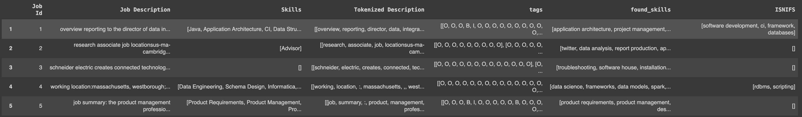
tokenization and bio tagging
Performed sentence level tokenization followed by word tokenization,
Performed pattern matching to create BIO tags.
Extracted skills using BIO tags.
Compared Extracted skills with skills mentioned explicitly in data.

Slide 6
Data Parsing
Flattened the job descriptions to create training data for token level classification.
Removed all sentences where no skills were mentioned.
Final dataset consisted of about 18000 BIO tagged sentences.
Job Id | Sentence | Tags
1 | [overview, reporting, director, data, integrat... | [O, O, O, B, I, O, O, O, O, O, O, O, O, O, O, ...
1 | [individual, expected, key, contributor, ideat... | [O, O, O, O, O, O, O, O, O, O, O, B, I, O, O, ...
1 | [position, play, important, role, producing, d... | [O, O, O, O, O, B, O, O, O, O, O, O, O, O, O, ...
1 | [opportunity, part, innovative, engineering, t... | [O, O, O, O, O, O, O, O, O, O, O, O, O, O, O, ...
1 | [responsibilities, designs, ,, codes, ,, verif... | [O, O, O, O, O, O, O, O, O, O, O, O, O, O, O, ...

Slide 7
(cont.)
We used a distilbert_base_uncased tokenizer to perform sub-word tokenization on our sentences. This led to misalignment in our sentence tokens and BIO tags.
Truncated and padded all sentences to 512 words.
We created a custom function to align tags with the subword tokens.
[CLS] | overview | reporting | director | data | integration | services | , | er | ##t | looking | full | stack
-100 | 0 | 0 | 0 | 1 | 2 | 0 | 0 | 0 | 0 | 0 | 0 | 0
developer | work | key | stakeholders | applying | technical | proficiency | across | different | stages | software | development | life
0 | 0 | 0 | 0 | 0 | 0 | 0 | 0 | 0 | 1 | 2 | 2 | 2
cycle | including | requirements | gathering | , | application | architecture | design | . | [SEP] | [PAD] | [PAD] | [PAD]
0 | 0 | 0 | 0 | 1 | 2 | 0 | 0 | 0 | -100 | -100 | -100 | -100

Slide 8
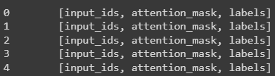
Final Training data
Challenge
Faced a dimension mismatch issue between the input ids and BIO tags.
Resolution
Squeezed to remove all unnecessary dimensions.
Transformed the data to train disbert-base-uncased model. Final data consisted of input ids, attention masks and labels where labels are the numeric BIO tags.
80-20 Train-Test split.
Used a data collator for tensor conversion and batching ensuring that the data is correctly formatted for the model.
Future work
3-fold-CV

Slide 9
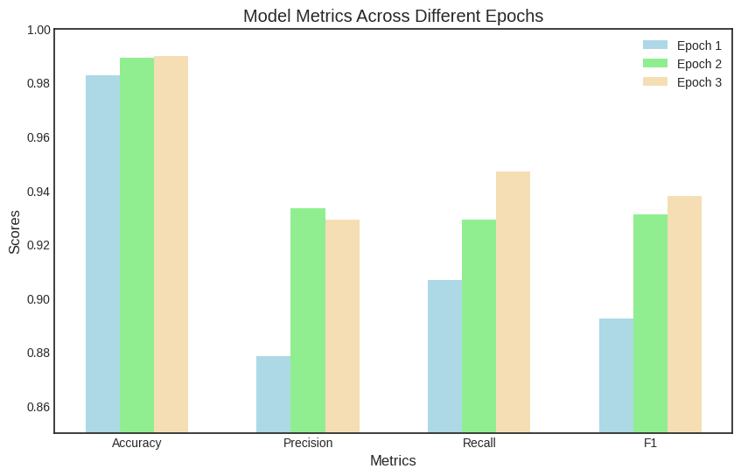
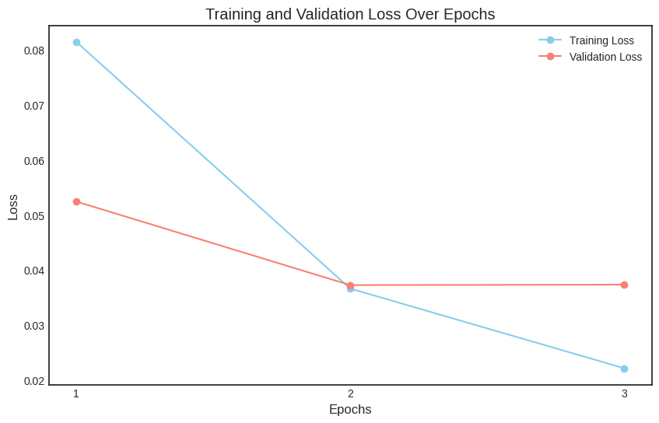
Preliminary Results
We trained for 3 epochs with a constant learning rate of 0.00005
Training ran for 40 minutes
We can see the model is performing quite well.
Epoch | Training Loss | Validation Loss | Precision | Recall | F1 | Accuracy
1 | 0.081500 | 0.052436 | 0.878380 | 0.906783 | 0.892356 | 0.982703
2 | 0.036600 | 0.037228 | 0.933150 | 0.929218 | 0.931180 | 0.989165
3 | 0.022100 | 0.037300 | 0.929096 | 0.946809 | 0.937868 | 0.989842

Slide 10
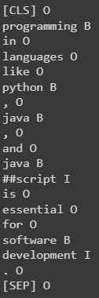
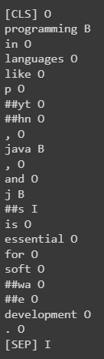
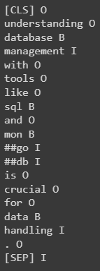
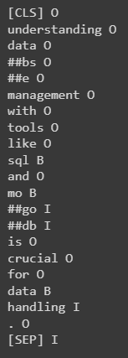
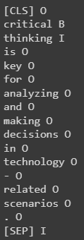
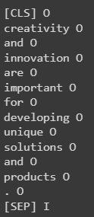
Model Inference
Tech skills
Sentence 1
Sentence 1
misspelled
Tech skills
Sentence 2
Sentence 2
misspelled
Soft skills
Sentence 1
Soft skills
Sentence 2

Slide 11
TO DO
Ensuring CLS, SEP and PAD tags are not mislabeled.
Postprocessing : Removing SEP, CLS tags are removed.
3 Fold Cross Validation for model refinement.
Final evaluation and further inference.

